Slide 1
Introduction to Software Engineering
CSSE3113

Slide 2
What Do We Mean by a Process?
Is a series of steps involving activities, constraints, and resources to produce an intended output
Prepare for exams
Conduct a software competition
Organize a trip
Write a term project report
Involves a set of tools and techniques
Block diagrams
Notations

Slide 3
How is a Process Useful?
Impose consistency and structure on a set of activities
Guide us to understand, control, examine, and improve the activities
Enable us to capture our experiences and pass them along

Slide 4
Characteristics of a Process
Prescribes all major process activities
Uses resources, subject to set of constraints (such as schedule)
Produces intermediate and final products
May be composed of sub-processes with hierarchy or links
Each process activity has entry and exit criteria
Activities are organized in sequence, so timing is clear
Each process guiding principles, including goals of each activity
Constraints may apply to an activity, resource or product

Slide 5
Software Lifecycle
When a process involves building a software (product), the process may be referred to as software (product) lifecycle
Requirements analysis and definition
System (architecture) design
Program (detailed/procedural) design
Writing programs (coding/implementation)
Testing: unit, integration, system
System delivery (deployment)
Maintenance

Slide 6
What is a Process Model?
Description of a process, evolved overtime, in a certain format
May use text, pictures, or a combination
Contains key process features

Slide 7
Why is a Process Model Needed?
To form a common understanding
To find inconsistencies, redundancies, omissions
To find and evaluate appropriate activities for reaching process goals
To tailor a general process for a particular situation in which it will be used

Slide 8
What is a Software Process Model?
Models that prescribe how should development of software progress
Models that describe how is software developed in actuality

Slide 9
Software Development Process Models
Waterfall model
V model
Prototyping model
Operational specification
Transformational model
Phased development: increments and iteration
Spiral model
Unified process
Agile methods

Slide 10
Waterfall Model
Situation:
When the user is clear in its requirement.
When the user wants/demands high quality software with documents.
User is willing to pay more funds and time.
One of the first process development models proposed
Works for well understood problems with minimal or no changes in the requirements
Simple and easy to explain to customers
It presents
a very high-level view of the development process
sequence of process activities
Each major phase is marked by milestones and deliverables (artefacts)

Slide 11
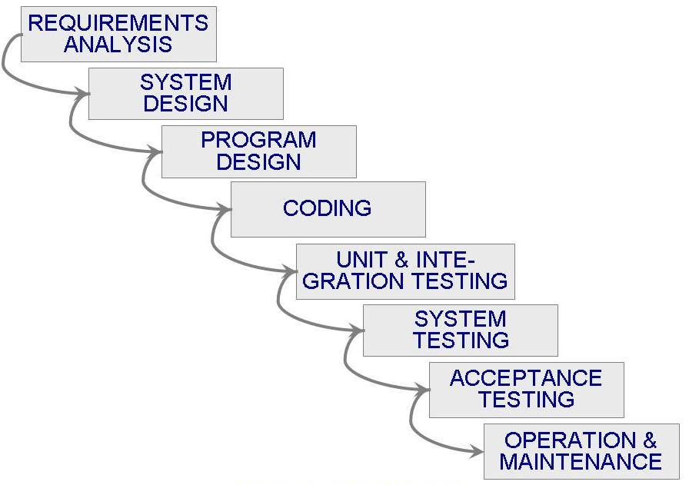
Waterfall Model (Contd.)

Slide 12
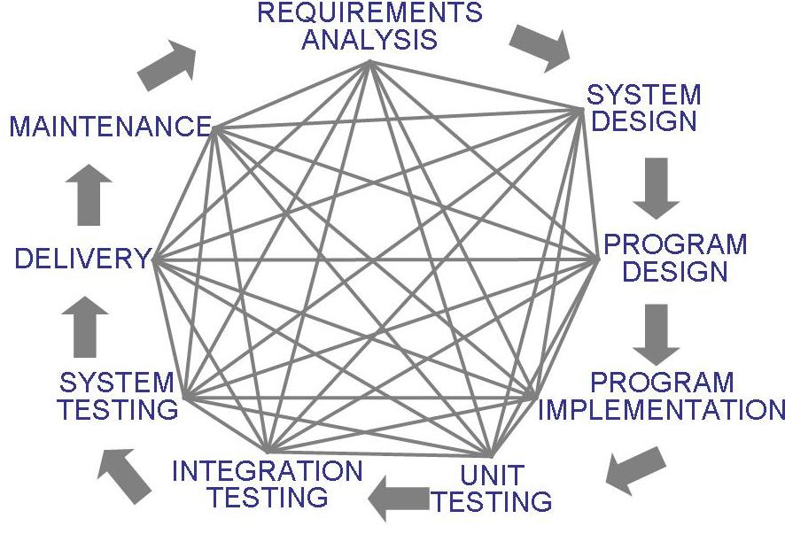
Waterfall Model (Contd.)
Uncontrolled Software Development Process
No Iterations in WF

Slide 13
Waterfall Model (Contd.)
Provides no guidance how to handle changes to products and activities during development (assumes requirements can be frozen)
Views software development as manufacturing process rather than as creative process
There is no iterative activities that lead to creating a final product
Long wait before a final product
Generates lots of documentation
Suitable for large projects

Slide 14
WaterFall model continued..
Advantages/Pros:
Development of high quality software
There is no time constrained.
Easy to manage and maintain.
Detailed/ Proper documentation is generated (process and result).
Disadvantages/Cons:
Practically difficult to implement.
Not suitable for complex projects.
Costly, Time consuming (no parallelism).
High Risk
Improper utilization of human resources.
More Effort in maintenance

Slide 15
Waterfall Model with Prototyping
A prototype is a partially developed product
Prototyping helps
developers assess alternative design strategies (design prototype)
users understand what the system will be like (user interface prototype)

Slide 16
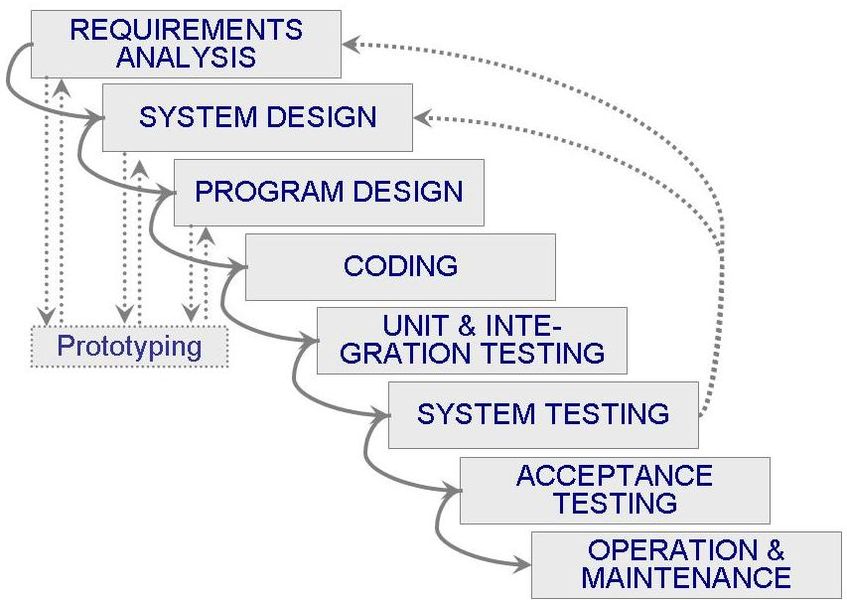
Waterfall Model with Prototyping

Slide 17
V Model
Situation:
It is recommended for safety critical software where extensive testing is required even in planning and designing phase.
A variant of the waterfall model
Uses unit and integration testing to verify procedural design
Uses system testing to verify architectural (system) design
Uses acceptance testing to validate the requirements
If problems are found during verification and validation, the left side of the V can be re-executed before testing on the right side is recreated.
Notes:
Verification means Are we building the product right?
It does not include the execution of the code.
Methods used in verification are reviews, walkthroughs, inspections and desk-checking.
Validation means Are we building the right product?
It includes the execution of the code.
Methods used in validation are Black Box Testing, White Box Testing and non-functional testing.

Slide 18
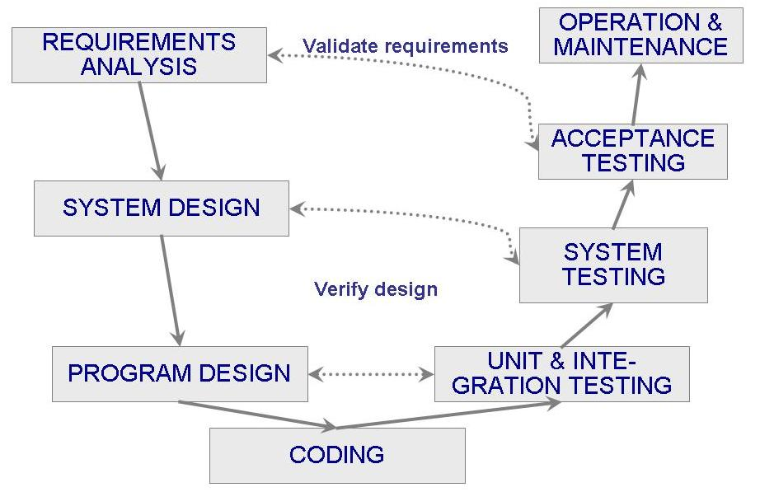
V Model (Contd.)

Slide 19
V model continued..
Advantages:
High quality.
User satisfaction.
Detailed documentation.
Errors and flaws are detected at early stages easily
Proactive approach
Disadvantages:
Testing overhead.
Time consuming.
Costly.
No feedback so less chance of changes.
Not good for big/object oriented projects.

Slide 20
Prototyping Model
Situation:
When user not clear in its requirement.
Allows repeated investigation of the requirements or design
Reduces risk and uncertainty in the development

Slide 21
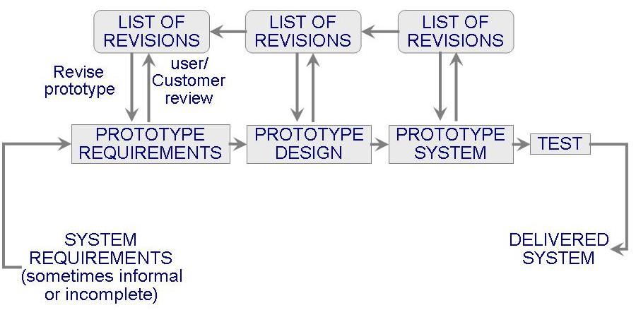

Slide 22
Prototyping Model (Contd.)
Types:
Evolutionary
Throwaway
Features
User involvement?
Smaller projects?

Slide 23
Prototyping model continued..
Advantages:
User satisfy.
Early feedback
Disadvantages:
Time consuming (requirement overhead).
User may expect the prototype as a final project
Costly.
Good for technical and requirement risks.
Sometimes software team build on the prototype to final project

Slide 24
Phased Development (Evolutionary model)
Cycle time
Time between when requirements document was written and when the system was delivered
Shorter cycle time
Decomposed system
System delivered in pieces
enables customers to have some functionality while the rest is being developed
Two systems functioning in parallel
the production system (release n): currently being used
the development system (release n+1): the next version

Slide 25
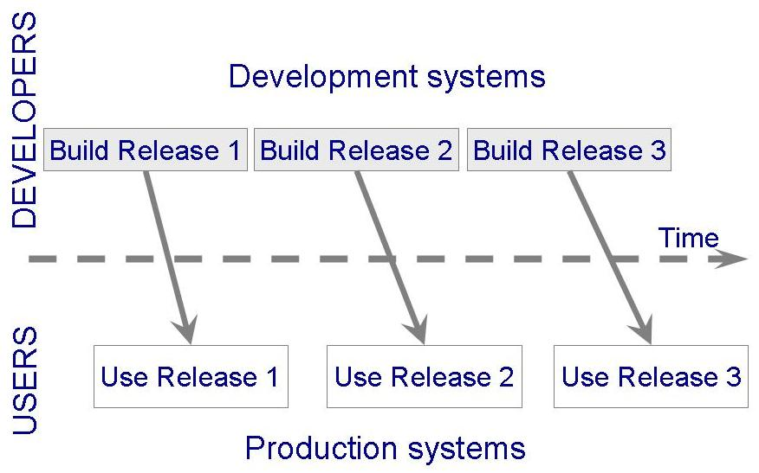
Phased Development (Contd.)

Slide 26
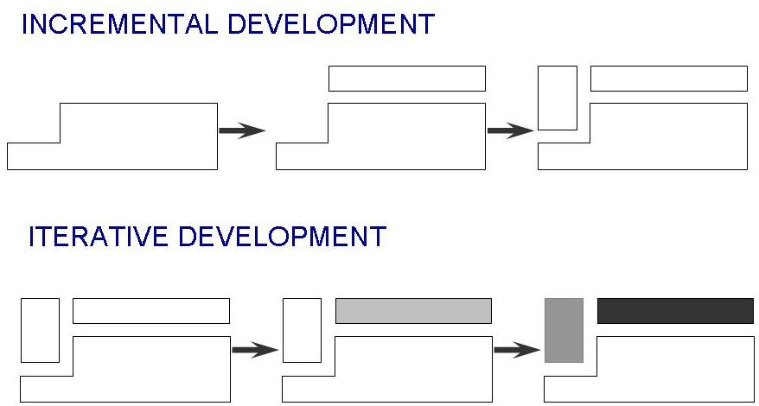
Phased Development (Contd.)
Incremental development: starts with small functional subsystem and adds functionality with each new release
Iterative development: starts with full system, then changes functionality of each subsystem with each new release

Slide 27
Phased Development (Contd.)
Training on early release
Responsive developers
Markets for early functionality
Quick and Global fixing on unanticipated problems
Ability to work on different areas of expertise with different releases
Better for large mission critical projects

Slide 28
Lecture 5

Slide 29
Spiral Model
Suggested by Boehm (1988)
Combines development activities with risk management to minimize and control risks
The model is presented as a spiral in which each iteration is represented by a circuit around four major activities
Determine goals, alternatives and constraints
Evaluate alternatives and risks
Develop and test
Plan next phase

Slide 30
Process is represented as a spiral rather than as a sequence of activities with backtracking
Each loop in the spiral represents a phase in the process.
No fixed phases such as specification or design - loops in the spiral are chosen depending on what is required
Risks are explicitly assessed and resolved throughout the process

Slide 31
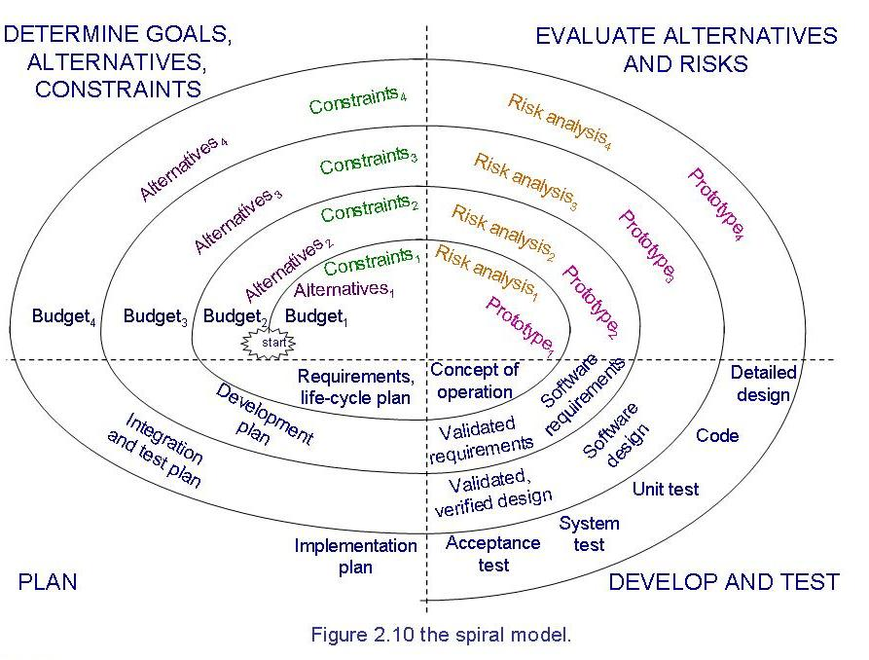
Spiral Model (Contd.)

Slide 32
Spiral Model (Contd.)
Advantages:
Risk handling
Large projects
Flexible
Customer satisfaction
Disadvantages:
Complex
Too much risk analysis
Expensive
time

Slide 33
Agile Methods
Emphasis on flexibility in producing software quickly and capably in rapidly changing environment
Agile manifesto
Concentrate on responding to change rather than on creating a plan and then following it (chaordic)
Value individuals and interactions over process and tools
Prefer to invest time in producing working software rather than in producing comprehensive documentation
Focus on customer collaboration rather than contract negotiation

Slide 34
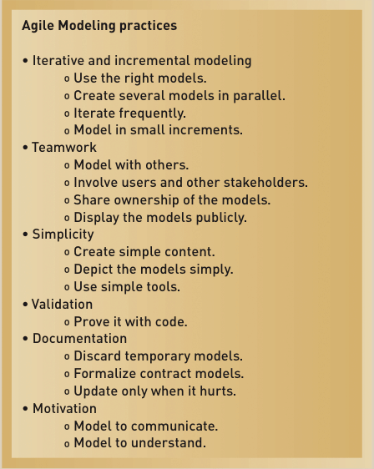
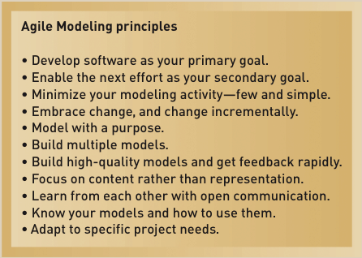
Agile Methods

Slide 35
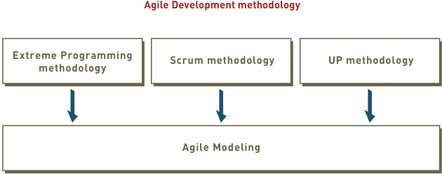
Agile Methods (Contd.)

Slide 36
Unified Process Model
Object-oriented system development methodology (system development process)
Offered by Rational/IBM, UP developed by Booch, Rumbaugh, and Jacobson
UP should be tailored to organizational and project needs
Highly iterative life cycle
Project will be use-case driven and modeled using UML

Slide 37
Unified Process Model (Contd.)
UP life cycle:
Includes four phases which consist of iterations
Iterations are “mini-projects”
Four Phases:
Inception – develop and refine system vision
Elaboration – define requirements and design and implement core architecture
Construction – continue design and implementation of routine, less risky parts
Transition – move the system into operational mode

Slide 38
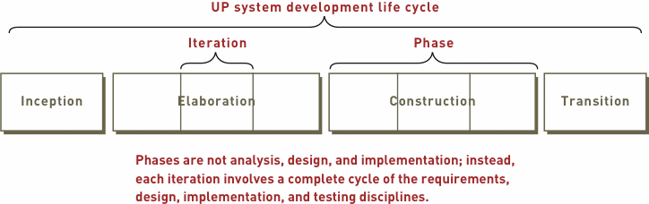
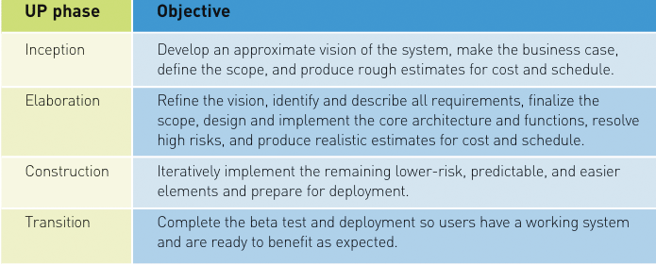
Unified Process Model (Contd.)
Images’ Source: Systems Analysis and Design in a Changing World, 4th Edition

Slide 39
Unified Process Model (Contd.)
Related development activities are called disciplines
UP disciplines:
Business modeling, requirements, design, implementation, testing, deployment, project management, configuration and change management, and environment
Each iteration includes activities from all disciplines
Activities in each discipline produce artefacts – models, documents, source code, and executables

Slide 40
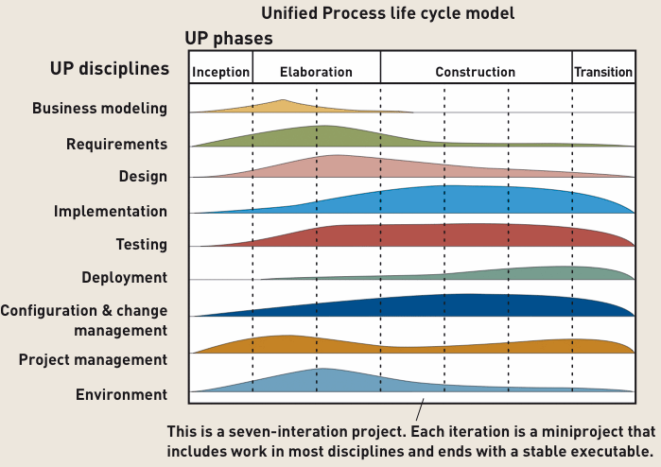
Unified Process Model (Contd.)
Image Source: Systems Analysis and Design in a Changing World, 4th Edition

Slide 41
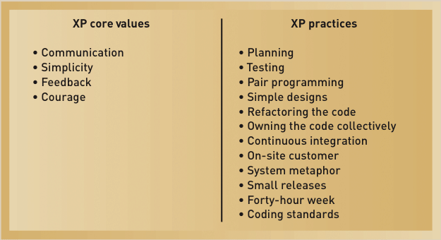
Agile Methods (Contd.)
Extreme Programming (XP)

Slide 42
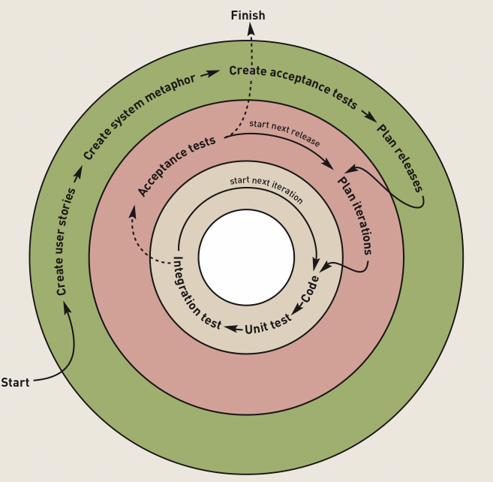
XP Development Approach

Slide 43
Agile Methods (Contd.)
Scrum:
A quick, adaptive, and self-organizing development methodology
Responds to a current situation as rapidly and positively as possible

Slide 44
Agile Methods (Contd.)
Scrum Philosophy
Responsive to a highly changing, dynamic environment
Focuses primarily on the team level
Team exerts total control over its own organization and work processes
Uses a product backlog as the basic control mechanism
The product backlog includes user functions (such as use cases), features (such as security), and technology (such as platforms).

Slide 45
Agile Methods (Contd.)
The product backlog list is continually being prioritized, and only a few of the high-priority items are worked on at a time, according to the current needs of the project and its sponsor.

Slide 46
Agile Methods (Contd.)
Scrum Organization
Product owner
The client stakeholder for whom a system is being built
Maintains the product backlog list
Scrum master
Person in charge of a Scrum project
Scrum team or teams
Small group of developers
Set their own goals and distribute work among themselves

Slide 47
Agile Methods (Contd.)
Scrum Practices
Sprint
The basic work process in Scrum
A time-controlled mini-project
Firm 30-day time box with a specific goal or deliverable
Parts of a sprint
Begins with a one-day planning session
A short daily Scrum meeting to report progress
Ends with a final half-day review

Slide 48
Comparison
XP
The main goal in XP is customer satisfaction.
Because of that, the XP method plans to test from the first day of development.
The planning game and test-driven development make it more feature-orientated than previous agile methodologies. Since it easily manages changes in later phases of development, it enables continuous integration.

Slide 49
Continue..
Scrum
Small teams work better
3-9 team members
Key role:product owner, scrum master and development team
Has 5 meetings
Has 2-4 week work cycle called sprints
Each sprint is another user story.

Slide 50
UP
Unified Process is a methodology that focuses on the importance of early planning in order to avoid risks, increase productivity, and meet customer satisfaction.
Unified Process is a team-based methodology
Unified process helps with project planning
Unified Process helps with identifying risks
Unified process has a lot of technical guidance

Slide 51
Special THANK FOR THE MATERIALS
Mr. Haroon Abdul Waheed
Prof. Zeeshan Ali Rana
Engr. Sajid Saleem
Pfleeger’s Book slides from UCF
Software Fundamentals

